Slide 1

INTRODUCTION TO JINAN QUANHUA PACKING PRODUCT CO., LTD.
Presented by:
Chio and Shen
Overseas Sales Representatives

Slide 2
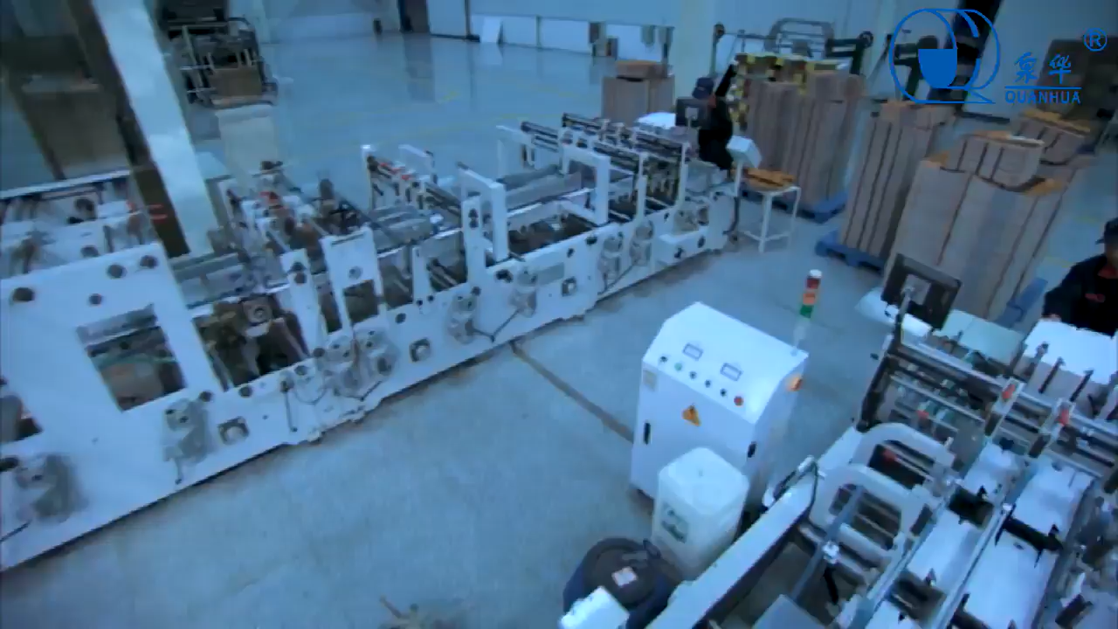

Slide 3
ABOUT QUANHUA PACKAGING
01
HIGH-QUALITY PACKAGING SOLUTIONS
02
TABLE OF CONTENTS
CERTIFICATIONS AND QUALITY ASSURANCE
03
OUR KEY PARTNERSHIPS
04
THE VALUE WE BRING
05

Slide 4

ABOUT QUANHUA PACKAGING
01

Slide 5


OUR COMPANY
Founded in 2000, Quanhua Packaging is a leading manufacturer of gable-top cartons and aseptic packaging solutions, specializing in packaging that preserves the quality of liquid products.

Slide 6
ABOUT QUANHUA PACKAGING
Over 300 million units produced annually, ensuring we meet global demand with efficiency and reliability.
450 employees dedicated to delivering high-quality packaging solutions worldwide.
We serve customers in over 50 countries, with a strong focus on expanding into North America, particularly the USA and Canada.
Jinan quanhua packing product co., Ltd.

Slide 7

Capturing 45% of China's liquid packaging demand, solidifying our position as a leader in the industry.
Certified under ISO 9001, ISO 22000, and FDA standards, ensuring the highest levels of quality and compliance with international food safety regulations.

Slide 8
DURABILITY AND
FRESHNESS
OUR COMMITMENT TO QUALITY AND SUSTAINABILITY
INNOVATIVE TECHNOLOGY
Our packaging solutions are engineered for durability and freshness, using eco-friendly materials that reduce waste and minimize environmental impact, helping your brand meet sustainability goals.
Leveraging cutting-edge technology imported from Japan and Canada, we lead the industry in providing innovative, superior packaging solutions that preserve the integrity and quality of your products.

Slide 9
HIGH-QUALITY PACKAGING SOLUTIONS
02

Slide 10

HIGH-QUALITY PACKAGING SOLUTIONS
GABLE-TOP CARTONS
ASEPTIC PACKAGING
PLASTIC CAPS
Ideal for packaging a wide range of beverages like milk, yogurt, juice, and tea. Our gable-top cartons preserve the quality and freshness of your products while being easy to store and transport.
Engineered for extended shelf life without the need for refrigeration. Perfect for maintaining product quality, safety, and taste over long periods, ensuring convenience for both producers and consumers.
An essential complement to our carton solutions, our durable plastic caps ensure your products remain securely sealed, preserving freshness and preventing leaks during transport and storage.

Slide 11
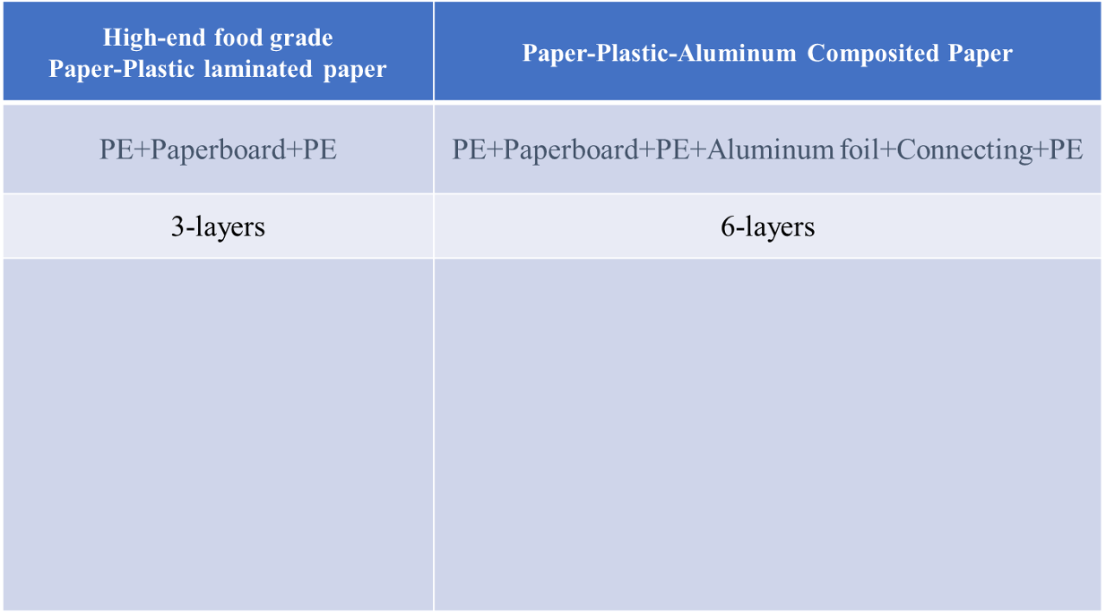
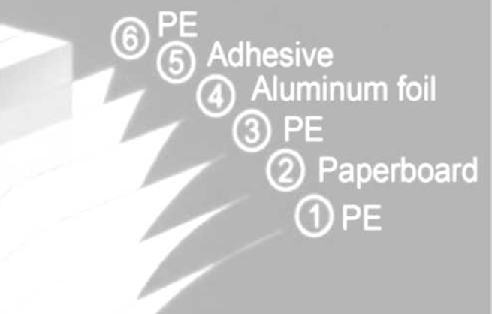
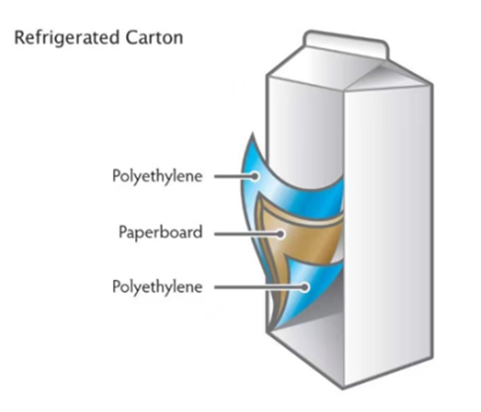
PE-COATED PAPER STRUCTURE

Slide 12
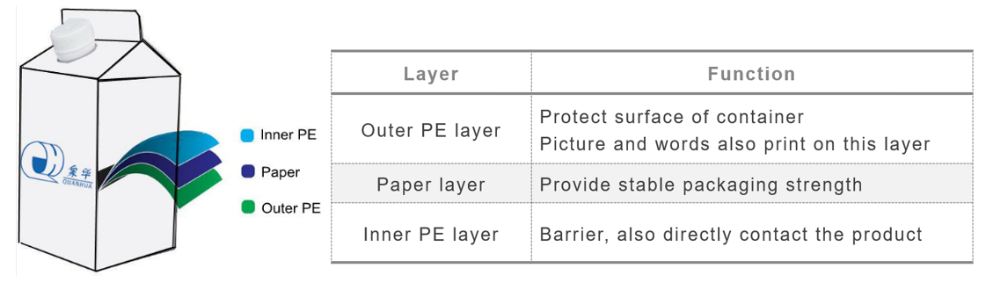
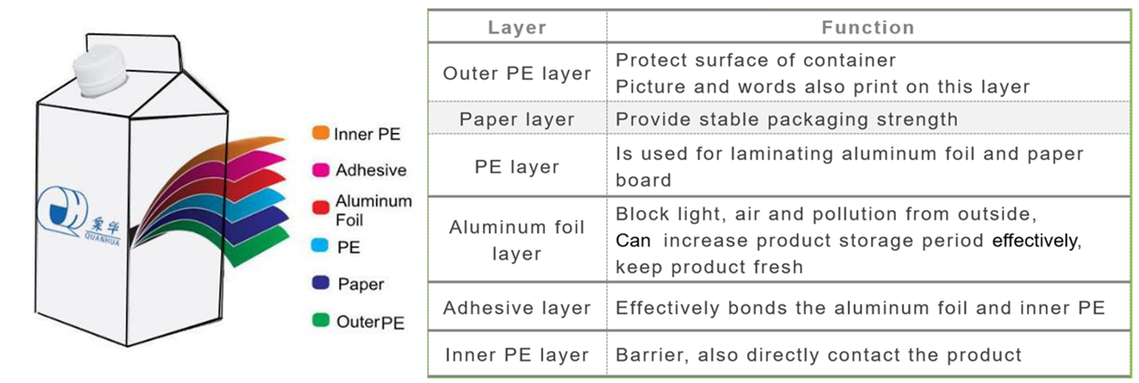
PE-COATED PAPER STRUCTURE

Slide 13
PRESERVING QUALITY: BARRIER AND SHELF LIFE BENEFITS
Barrier Performance: The packaging effectively blocks oxygen, bacteria, and other external factors, ensuring the contents remain fresh and retain their nutritional integrity. For example, in food packaging, it helps preserve the original flavor and quality for longer.
Moisture and Oxidation Resistance: The packaging provides excellent resistance to moisture and prevents oxidation, which helps extend the shelf life of the product by preventing degradation and maintaining its freshness over time.

Slide 14
SERVICE ASSURANCE
Quality Control : Equipped with state-of-the-art quality control instruments.
Process: Rigorous inspections from raw material procurement to product shipment.
Guarantee: Ensures consistent product quality and reliability.

Slide 15
CERTIFICATIONS AND QUALITY ASSURANCE
03

Slide 16
CERTIFICATIONS AND QUALITY ASSURANCE
ISO 9001 → Comprehensive Quality Management System ensuring consistent and superior product quality across all operations.
ISO 14001 → Commitment to Environmental Management practices, minimizing our ecological footprint and promoting sustainability.
ISO 22000 & FSSC 22000 → Advanced Food Safety Management Systems that guarantee the safety of food and beverage packaging for consumers.
FDA & QS Certifications → Compliance with FDA and QS standards ensures that our packaging meets stringent U.S. food and beverage regulations, providing peace of mind to both manufacturers and consumers.

Slide 17
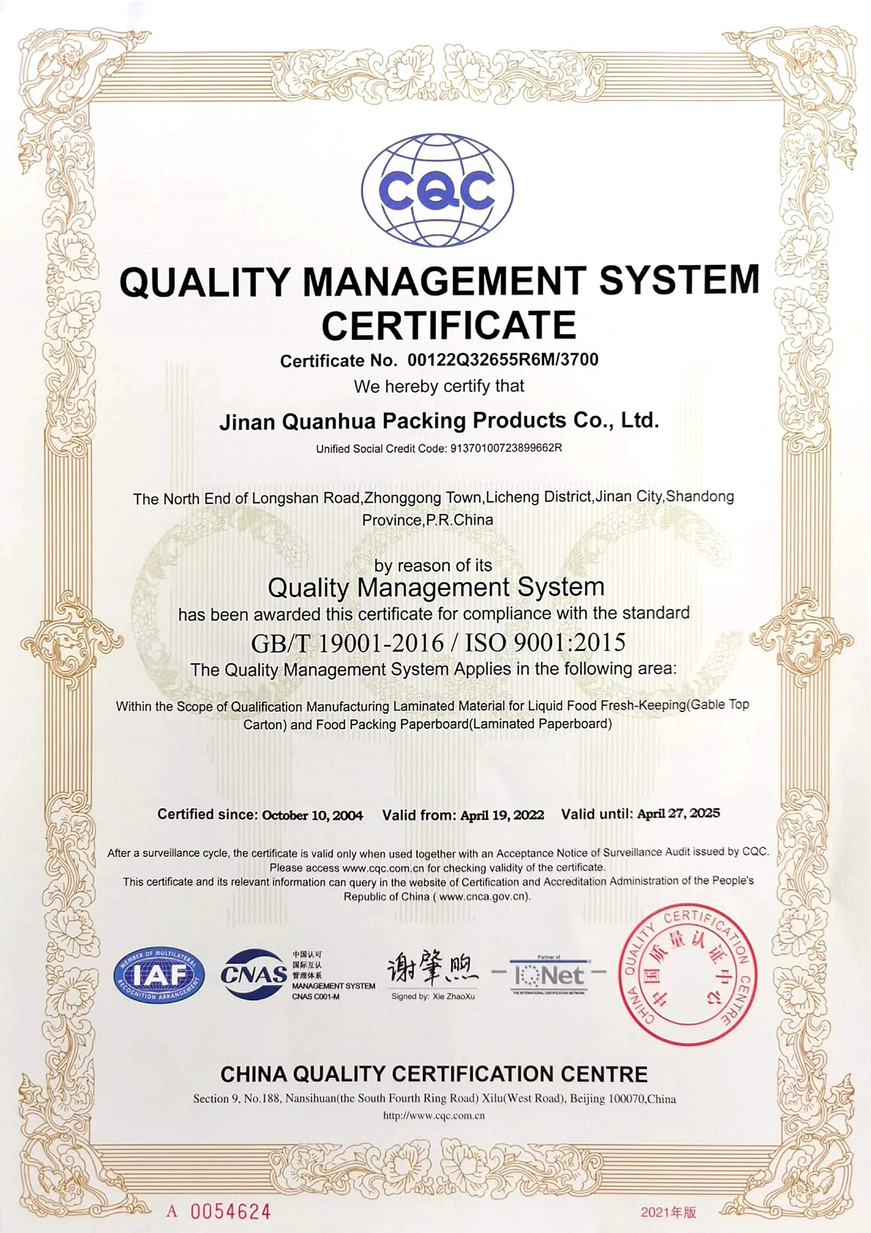
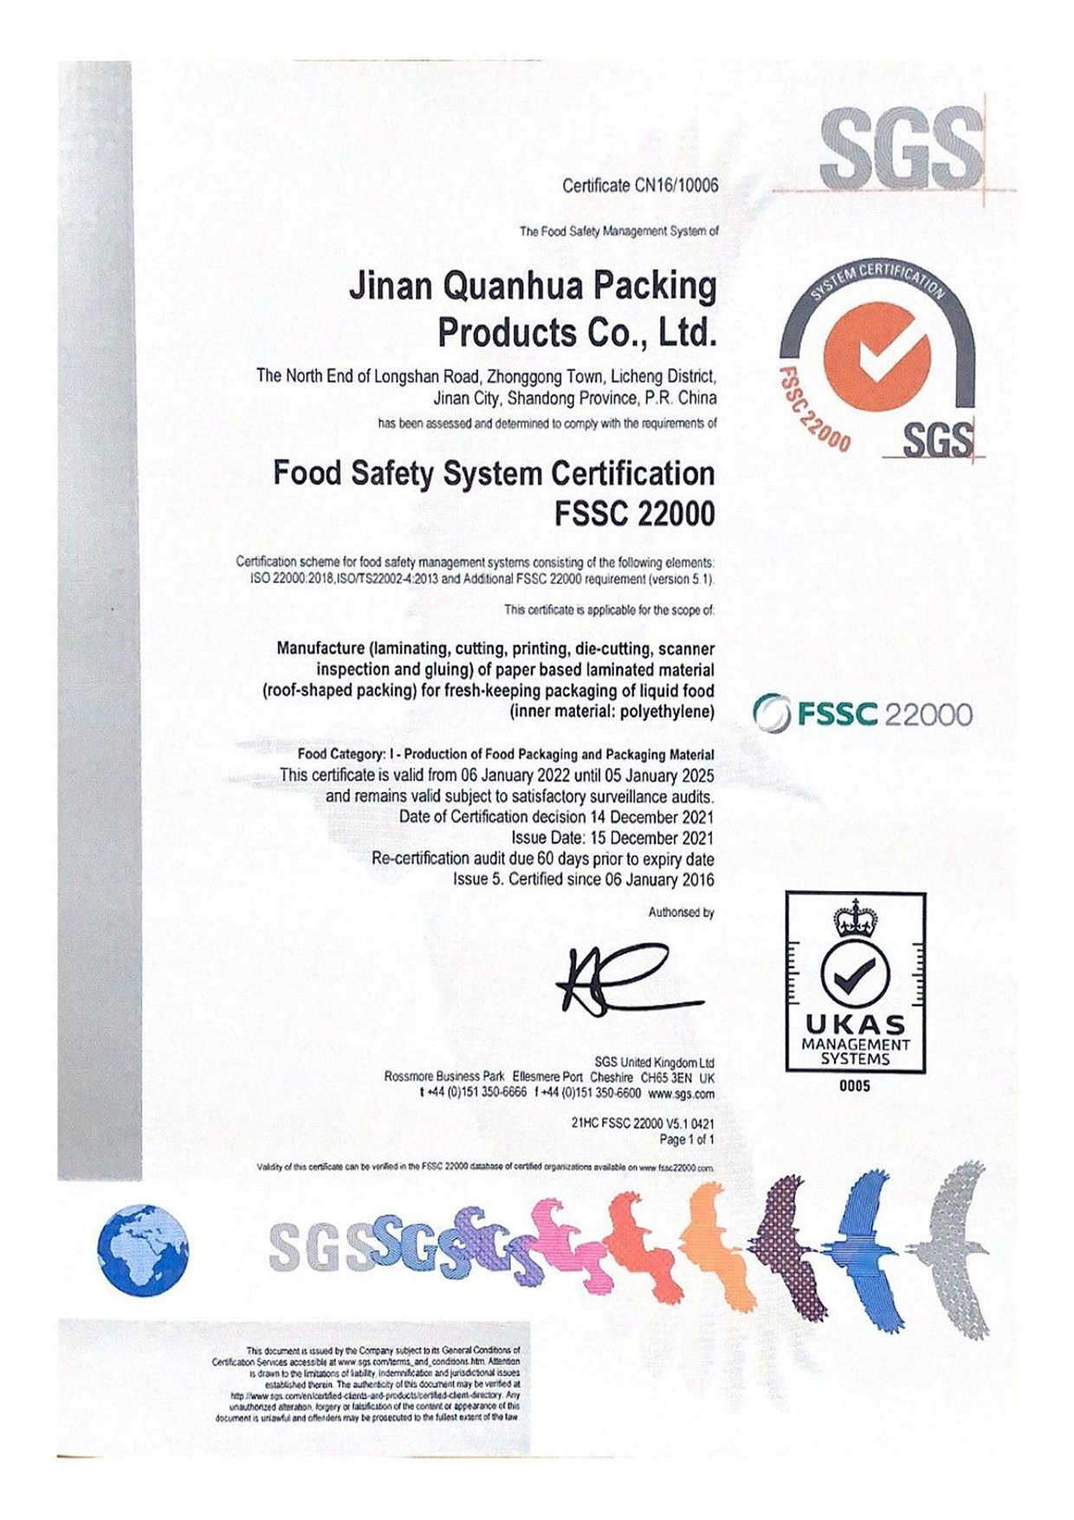
CERTIFICATIONS AND QUALITY ASSURANCE

Slide 18
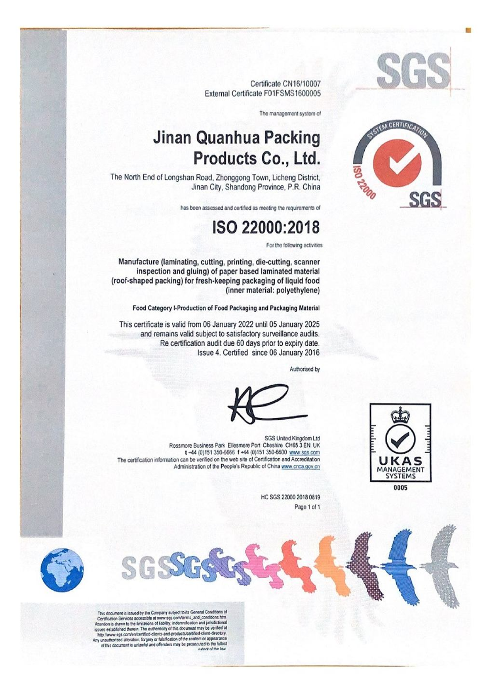
CERTIFICATIONS AND QUALITY ASSURANCE

Slide 19
HIGH-QUALITY PRODUCTION WITH ADVANCED EQUIPMENT AND TECHNOLOGY
At Quanhua Packaging, we leverage world-class equipment and premium raw materials to deliver industry-leading packaging solutions. By integrating cutting-edge Japanese technology, we ensure our products meet the highest standards of performance and reliability.
Our professional quality control team conducts rigorous testing at every stage of production. With a comprehensive quality management system, we guarantee that all finished products are thoroughly inspected and meet international standards before they are shipped.

Slide 20
AQUAFLEX MULTI-COLOR FLEXO PRINTING MACHINES (Imported from Canada)
STATE-OF-THE-ART EQUIPMENT
HIGH-QUALITY PRODUCTION WITH ADVANCED EQUIPMENT AND TECHNOLOGY
We operate with advanced machinery to ensure the highest quality packaging:
Cutting-edge printing technology that delivers vibrant, high-quality print results on every package.
HIGH-SPEED SEALING MACHINES
(Imported from Taiwan)
FULLY AUTOMATIC DIE-CUTTERS
Precision die-cutting for consistent, efficient production with minimal waste
Industry-leading sealing technology that ensures secure, airtight packaging for long-lasting product freshness.

Slide 21
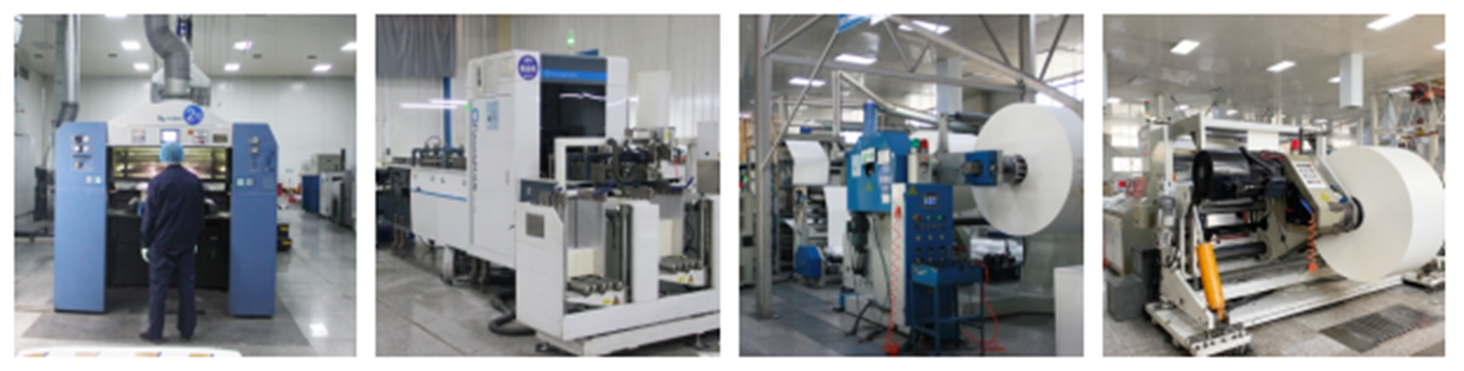
ADVANCED EQUIPMENT

Slide 22
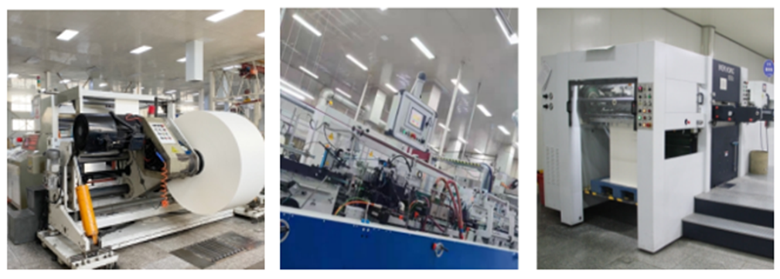
ADVANCED EQUIPMENT

Slide 23
ADVANCED EQUIPMENT
Printing machines:
6 colors
Offset and flexo printing
High-accuracy, high-quality
Sorting machine:
High stability, high-efficiency
Automatic box folding-gluing machine: Stable performance, simple operation
Die-cutting machine:
High precision, easy operation
long service life, low cost

Slide 24






HIGH-QUALITY PRODUCTION WITH ADVANCED EQUIPMENT AND TECHNOLOGY
We prioritize the use of high-quality materials sourced from trusted suppliers worldwide to ensure exceptional product performance
MILK CARTON BOARD
PE
England INEOS and Japan Dupont Dow
Japan Polyethylene Corporation, JPE
USA weyerhaeuser andFinland storaenso,

Slide 25


HIGH-QUALITY PRODUCTION WITH ADVANCED EQUIPMENT AND TECHNOLOGY
We prioritize the use of high-quality materials sourced from trusted suppliers worldwide to ensure exceptional product performance
Ink
Germany Siegwerk
T&K TOKA

Slide 26
HIGH-QUALITY PRODUCTION WITH ADVANCED EQUIPMENT AND TECHNOLOGY
We integrate advanced Japanese technology into our production process
to ensure the highest quality and efficiency
FILLING MACHINES (Sourced from shikoku kakoki co., Ltd., Japan)
Precision filling machines designed for consistent, accurate filling, ensuring product safety and quality.
PRINTING INKS (Supplied by T&K TOKA Co., Ltd., Japan)
Superior printing inks that deliver vibrant and durable prints while meeting stringent safety standards for food and beverage packaging.
PLASTIC PELLETS (Sourced from Japan Polyethylene Corporation, JPE)
Premium-grade plastic pellets that ensure the durability and performance of our packaging materials.

Slide 27
OUR KEY PARTNERSHIPS
04

Slide 28

We proudly serve both domestic and global brands, offering tailored packaging solutions that preserve product quality and enhance brand image.

Slide 29
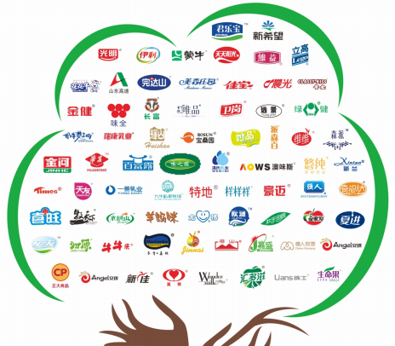
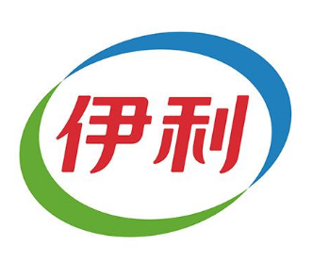
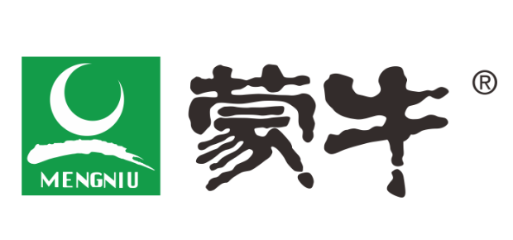
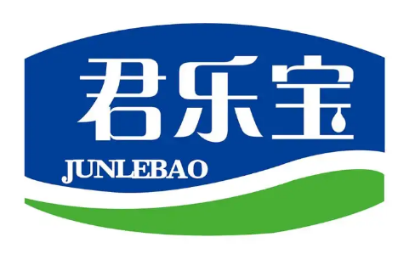

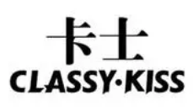
DOMESTIC BRANDS
Trusted by top companies within our home market, ensuring reliable, high-quality packaging solutions.
In domestic market:

Slide 30

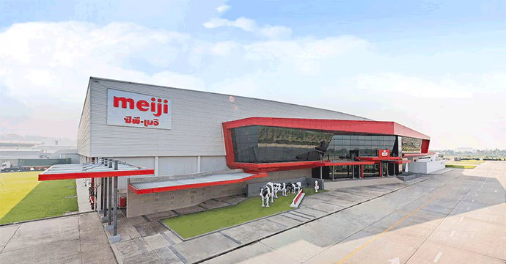
NESTLÉ
CP-MEIJI CO., LTD.
GLOBAL BRANDS
We collaborate with internationally recognized brands, delivering packaging solutions that meet global standards and consumer expectations.
One of the world’s largest food and beverage companies, relying on our innovative packaging to maintain product integrity and freshness.
Thailand’s leading dairy company, known for high-quality products and trusted packaging solutions.

Slide 31






GLOBAL BRANDS
We collaborate with internationally recognized brands, delivering packaging solutions that meet global standards and consumer expectations.

Slide 32
THE VALUE WE BRING
05

Slide 33
THE VALUE WE BRING IN
HIGH-QUALITY MANUFACTURING
CUSTOM SOLUTIONS
Our packaging solutions are designed to preserve the freshness and quality of your liquid products, ensuring they reach consumers in optimal condition.
We offer tailored packaging specifications that align with your product needs, ensuring a unique and impactful presentation.

Slide 34
THE VALUE WE BRING IN
SUSTAINABILITY
COST-EFFECTIVENESS
We prioritize eco-friendly materials and sustainable manufacturing processes, helping educe your environmental footprint while supporting your sustainability goals.
Enjoy competitive pricing without compromising on quality, offering the best value for your investment in packaging solutions.

Slide 35
THE VALUE WE BRING IN
GLOBAL EXPERIENCE
With reliable shipping systems and experience serving over 20 countries, we meet international standards, ensuring timely delivery and customer satisfaction.

Slide 36

Contact Us
Email: victorzhang@126.com
Phone: +86-531-82992736
Official Website: www.qhpackage.com
Made in China Product Page:
Quanhua Packaging on Made in China

Slide 37

THANK YOU
We look forward to the opportunity to cooperate with your company.

